Slide 1




R bius
A vision for Multi-Platform App Development in Rust
2023
Kevin Boos, Futurewei Technologies

Slide 2
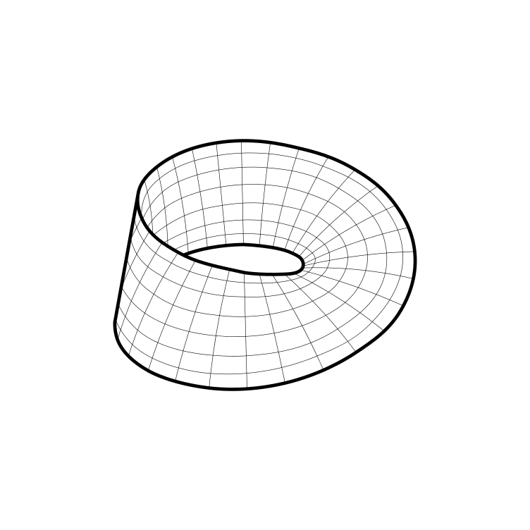

Robius at a glance
Create a cross-platform app dev toolkit completely in Rust
Devs can leverage the robust, safe, and performant Rust ecosystem
No need to complicate things with other languages
The Rust experience on Mobile feels neglected
Make Mobile a first-class concern in the Rust community

Slide 3

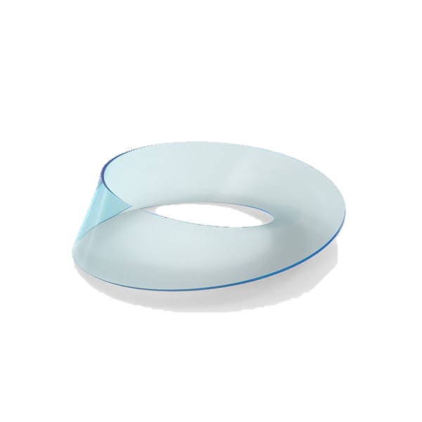
Disclaimer
Not formally affiliated with the Rust project or Rust Foundation

Slide 4

Motivation

Slide 5
What motivates our vision?
App devs want to use Rust, but aren’t sure where/how to start
Paralysis of choice among dozens of partial solutions
Unclear how to integrate many disparate projects
Business advantages are clear
Consistent experience for devs and customers
Avoid redundant dev effort → save money, faster time to market
Rust is great! (not for cross-platform apps, yet)
Safety → increased correctness, reliability
Performance efficiency → responsive, jank-free UI
Potential to unify two dev worlds: systems + frontend apps
→ Attract front-end developers to the world of Rust
Notes:
Unclear integration opportunities
Which crates work with which others?
Poor documentation; lack of examples, tutorials
Business case/perspective – why is this needed?
Evidence – why was Flutter created?
Rust offers safety and performance
Safety leads to increased correctness, eliminating memory & concurrency bugs
Higher reliability, less developer frustration and debugging difficulties
Amenable to formal verification and type-carried invariants
Less runtime overhead via static (compile-time) checking and guarantees
Focus on zero-cost abstractions (e.g., async state machines)
No garbage collection, static memory lifetime analysis
Monomorphization of generics
const eval, etc
Interactive systems, especially mobile, require good performance and efficiency; achievable with Rust
Performance is key for a smooth, responsive UI without jank
Efficiency is key for longer battery life, less heat output
Built-in support for easy cross-platform compilation targeting
Good, clear dependency management via cargo

Slide 6
1. State of the Rust app dev ecosystem is rough
Fractured ecosystem – many competing crates
No official recommendation for any specific toolkit(s)
Discovery of crates is difficult, non-standardized
Many crates offer overlapping features, are abandoned/incomplete
Unclear integration opportunities
Which crates work with which others?
Poor documentation; lack of examples, tutorials
Notes:
Fractured ecosystem – many competing crates
Competition is good, but most of the projects are incomplete
Official Rust project team/ecosystem doesn’t recommend any specific toolkit
Discovery of crates is difficult, non-standardized
Many crates offer overlapping features, are abandoned/incomplete

Slide 7
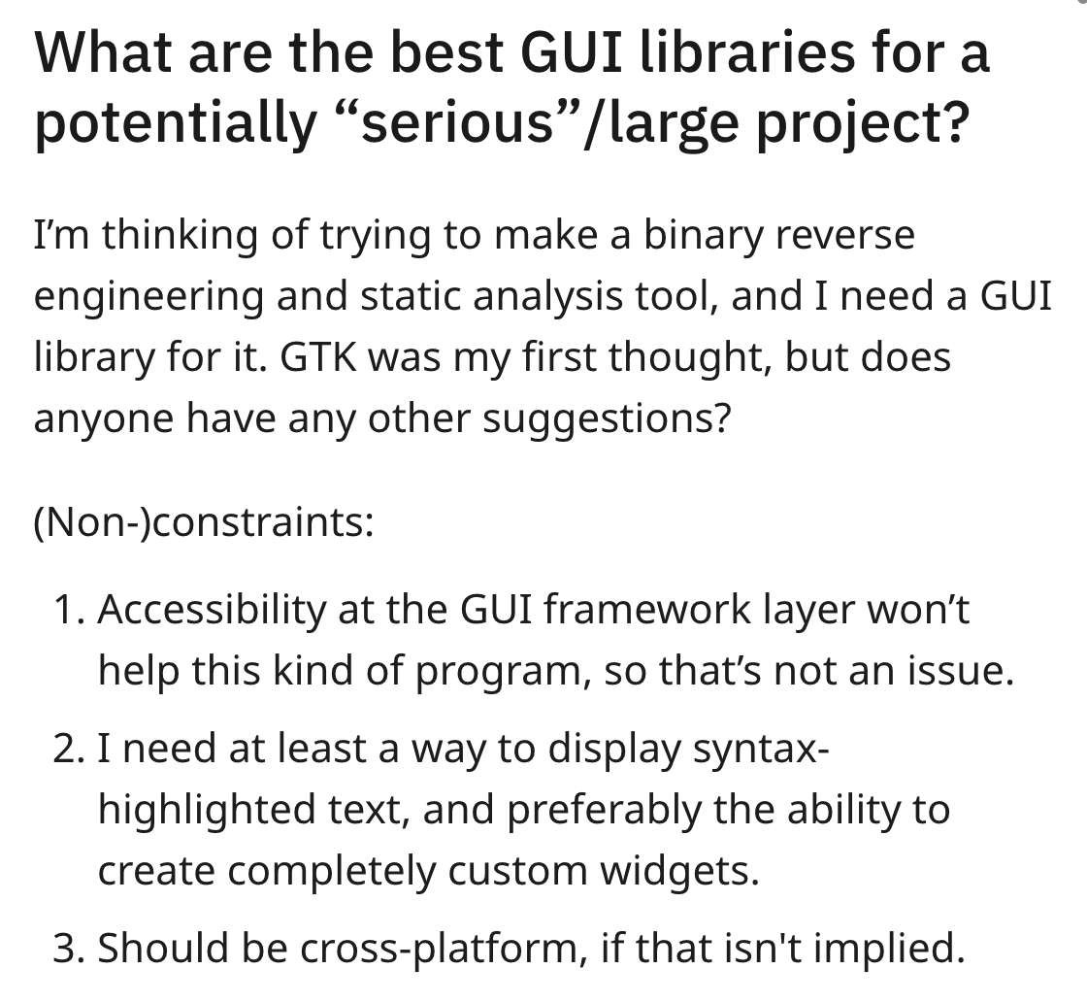
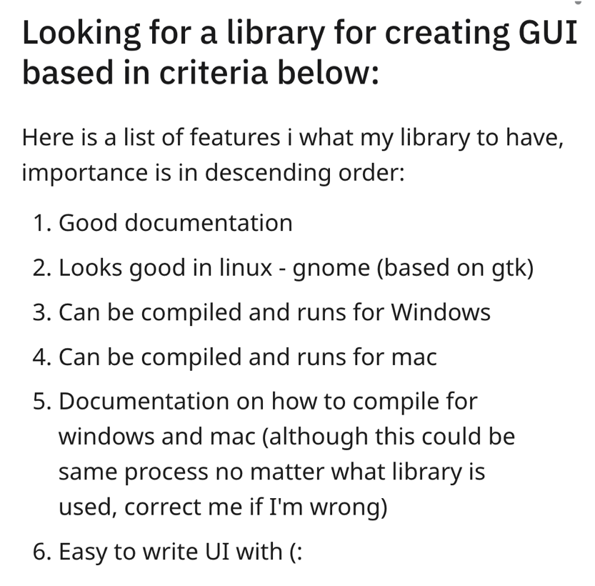
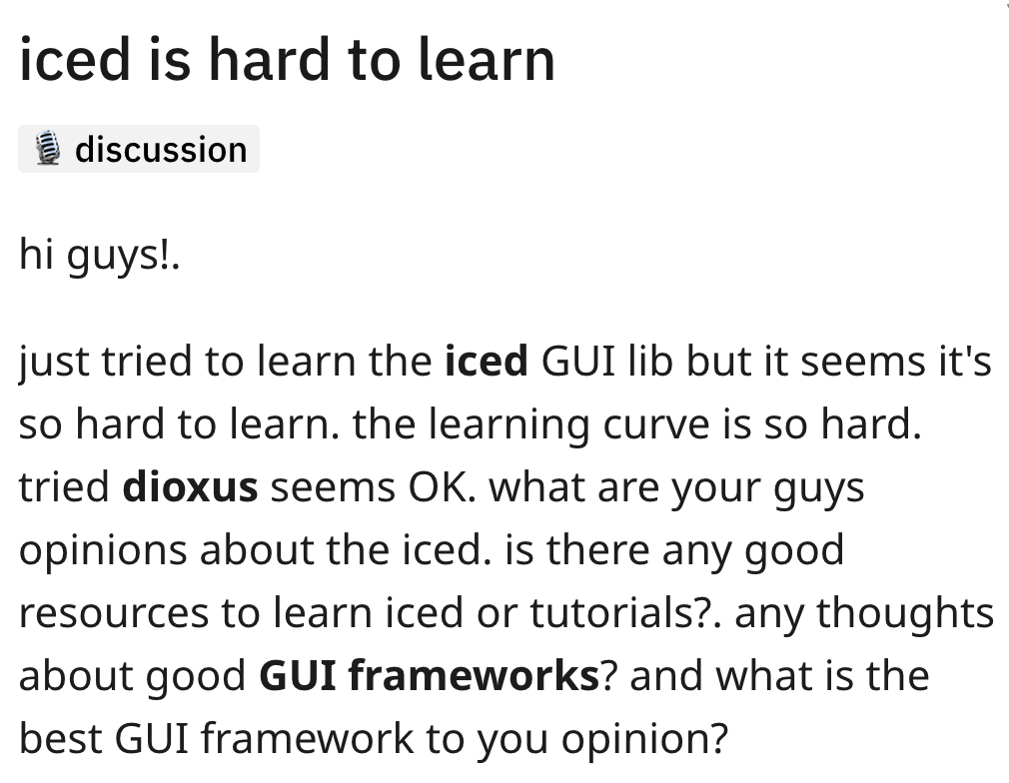

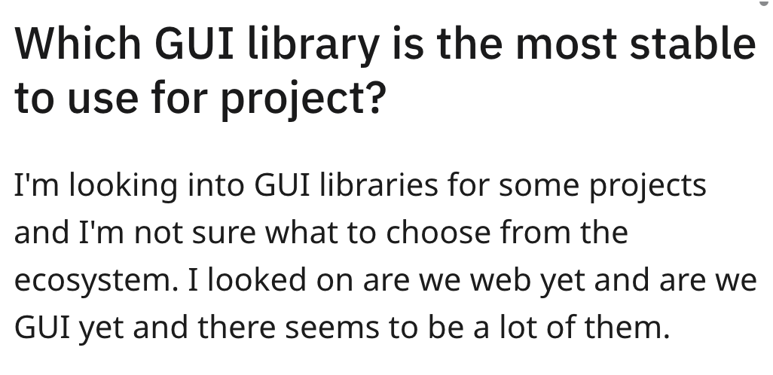
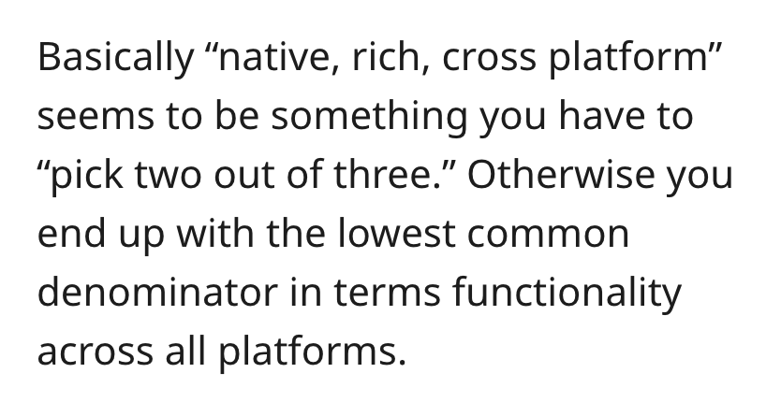
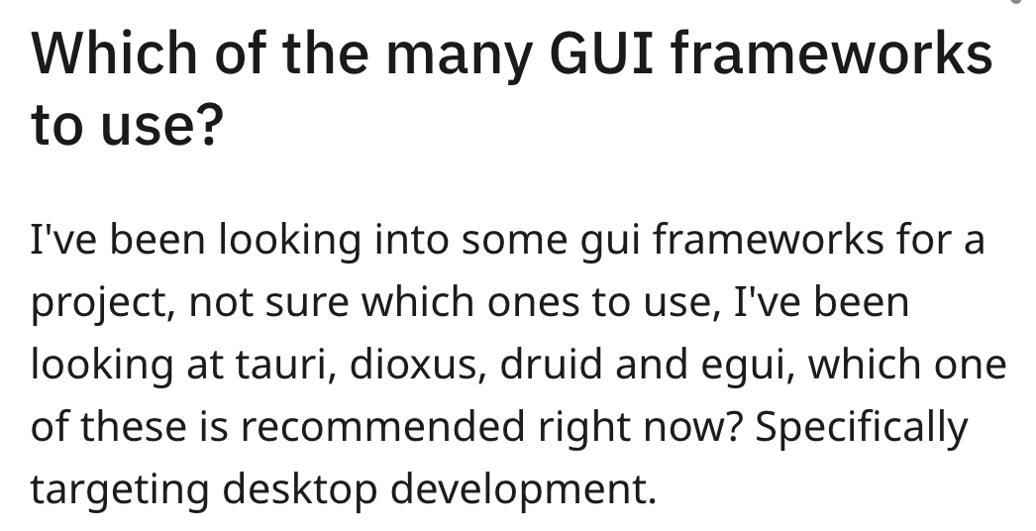
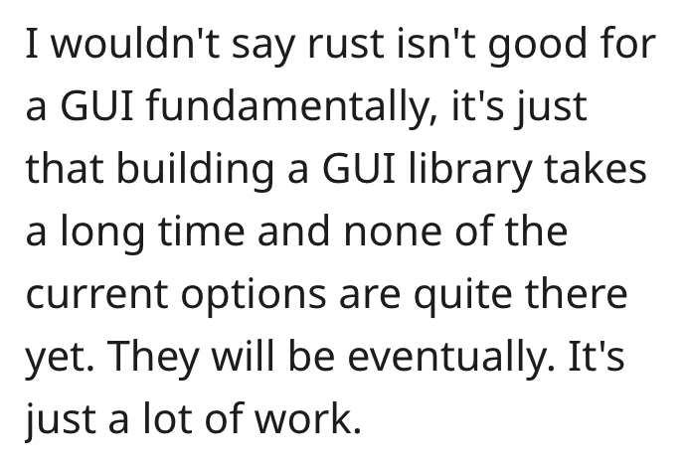
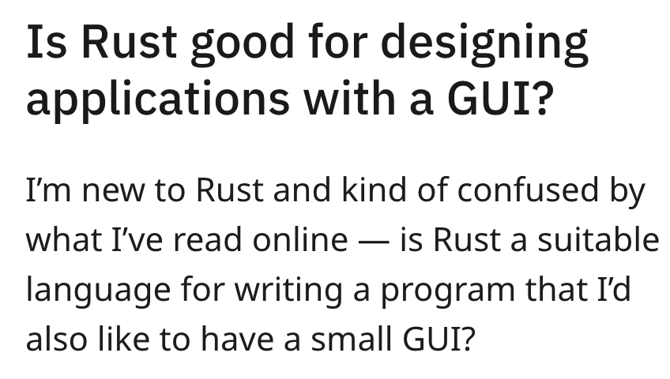
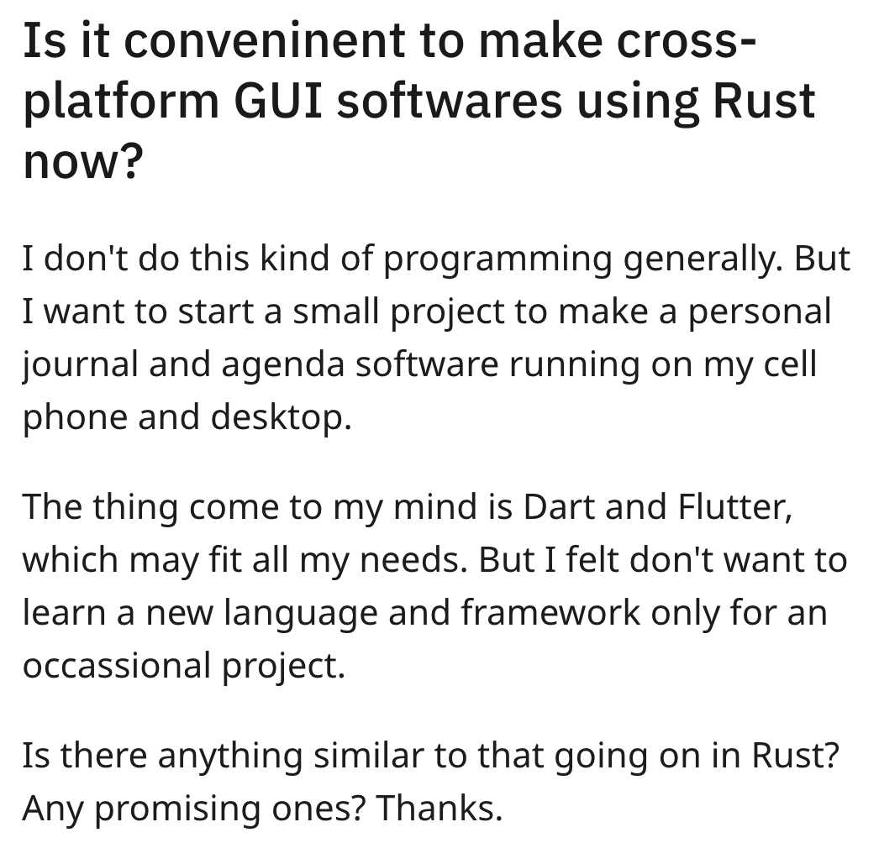
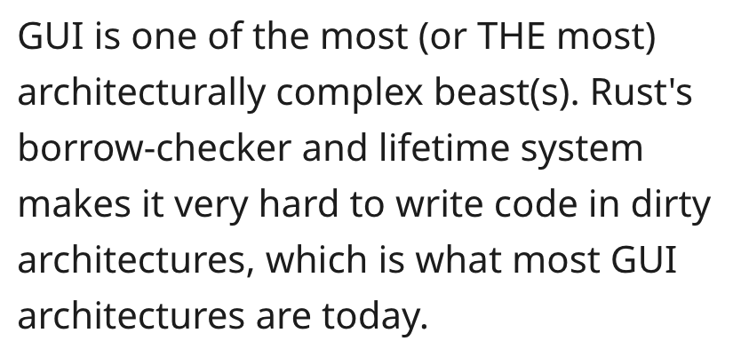
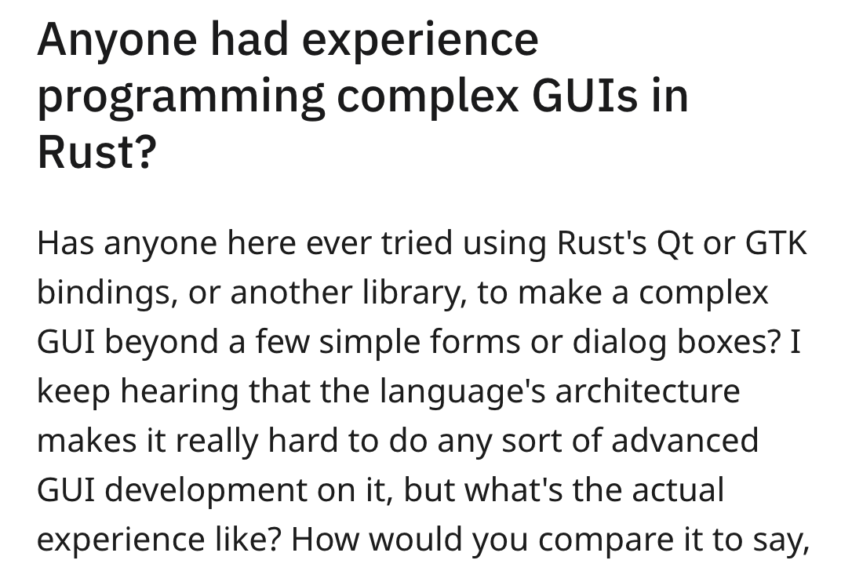
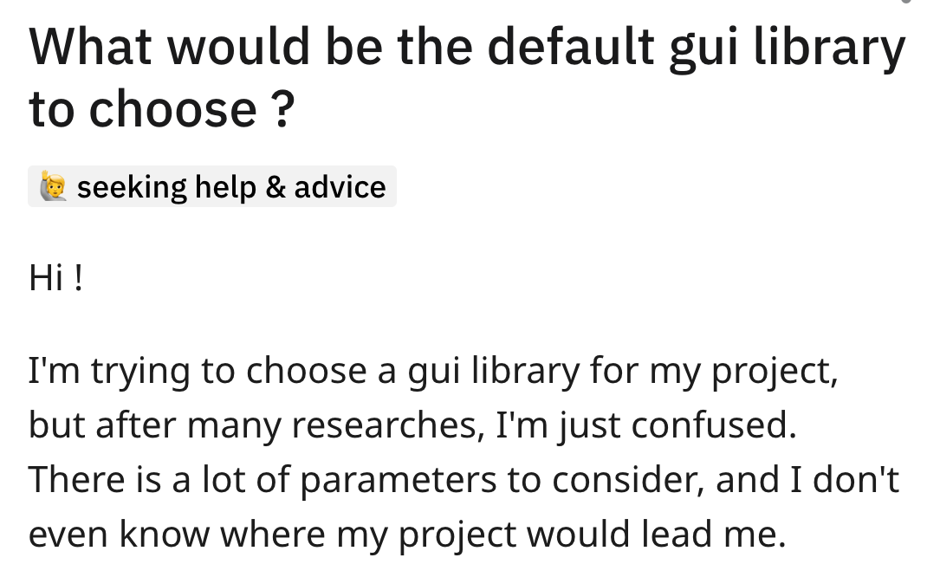
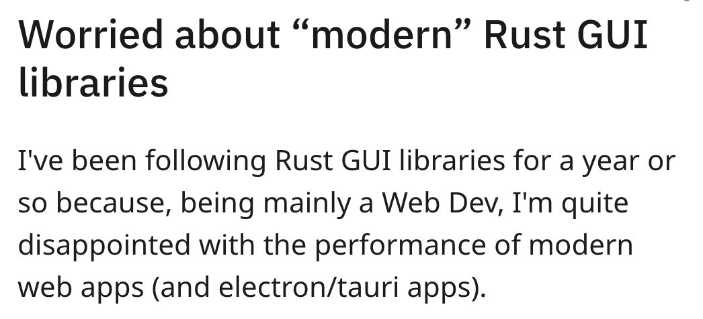
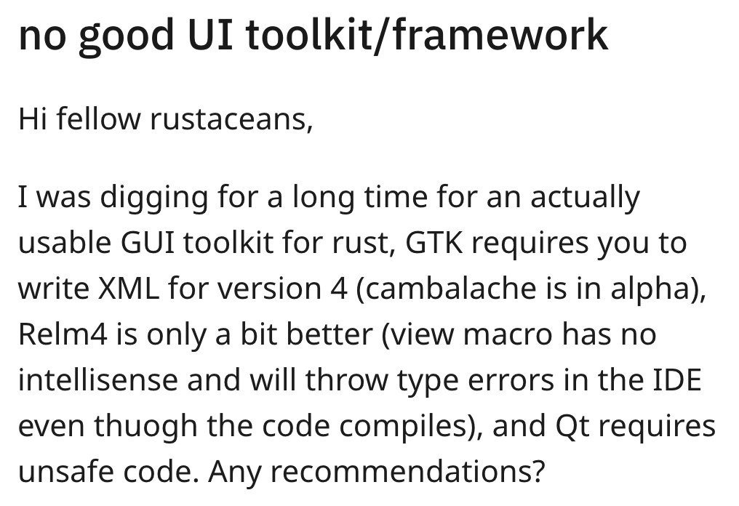
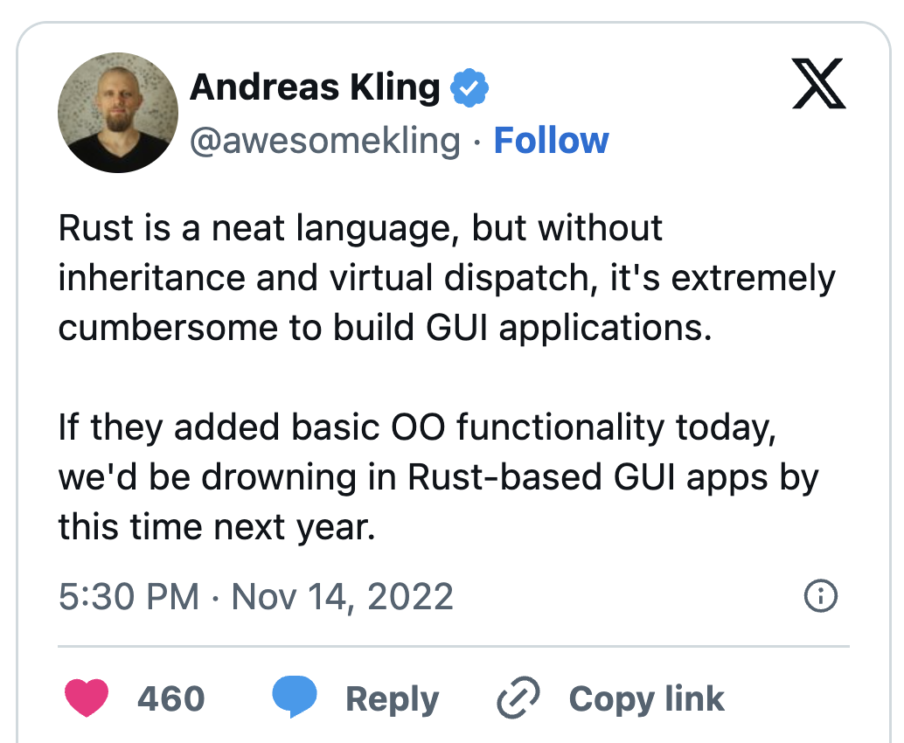
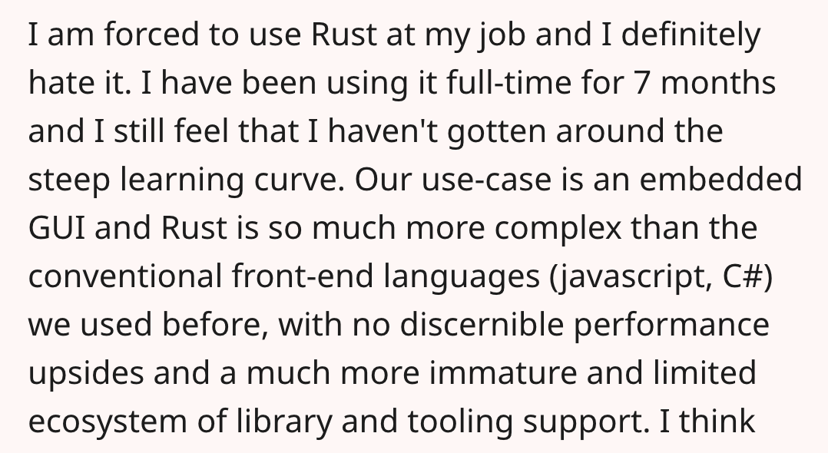
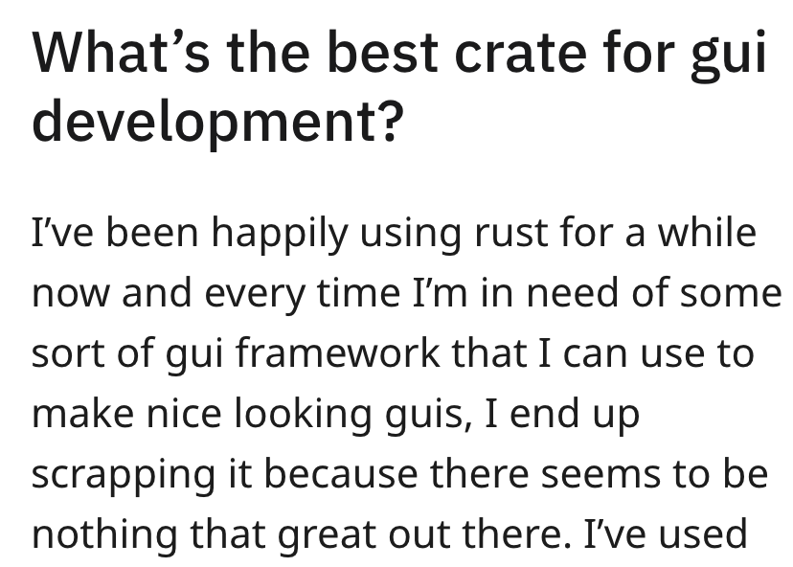
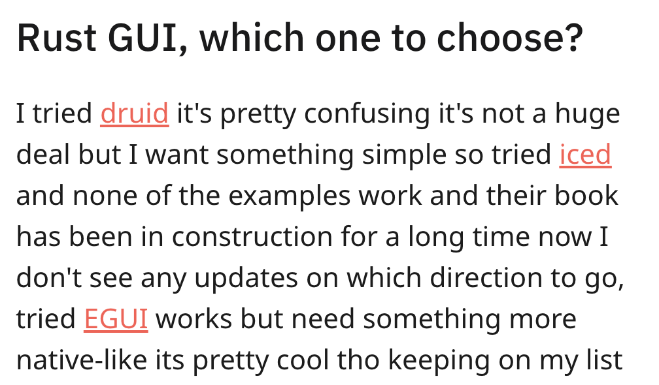
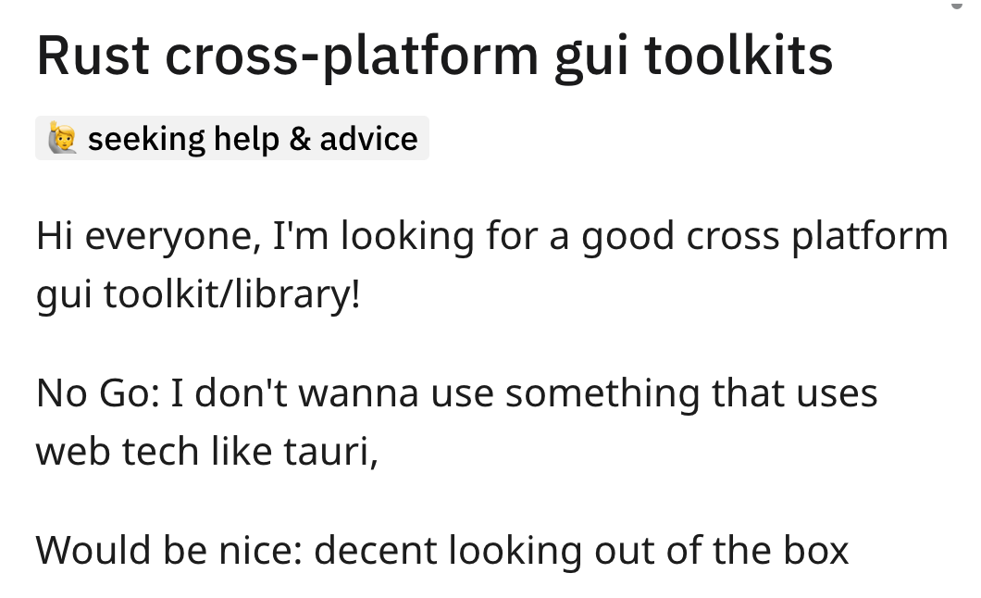
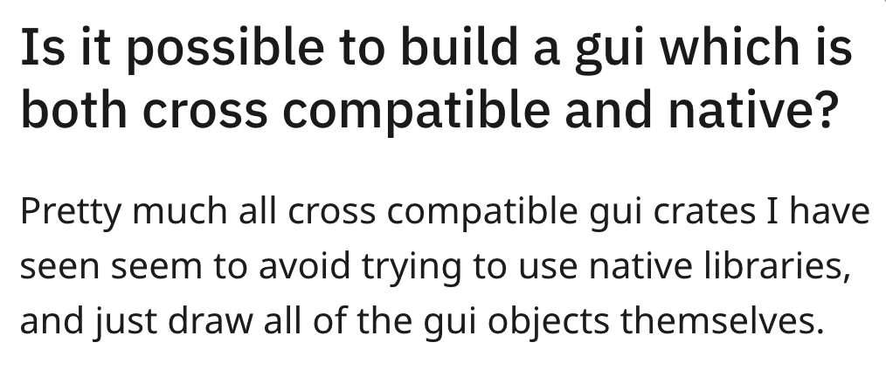

1. State of the Rust app dev ecosystem is rough
Notes:
If you don’t believe me, just search “Rust mobile app” or “UI in Rust” on any Rust forum or reddit page, and you’ll find hundreds, if not thousands of posts asking basically the same question

Slide 8
ok, ok, we get it

Slide 9

2. A strong business case for Rust app dev
Apps developed (partially) in Rust have platform-related pain points
Signal-iOS
Signal-Android
Signal-Desktop
Signal-Server
Swift UI
Java / Kotlin
TypeScript / JavaScript
Java EE
LibSignal (Rust)
iOS
Android
Desktop OS
Server OS
Notes:
Another motivating factor for the Robius vision is that there is a strong business case to be made for application development in Rust.
The current set of existing major applications that are written in Rust all use Rust primarily for implementing an internal business logic layer.
As such, they have lots of fragmentation and unnecessary, expensive redundancy.
Signal maintains multiple application repositories, each with multiple languages that must interoperate with each other in complex manners,
with applications being developed separately on a per-platform basis.

Slide 10
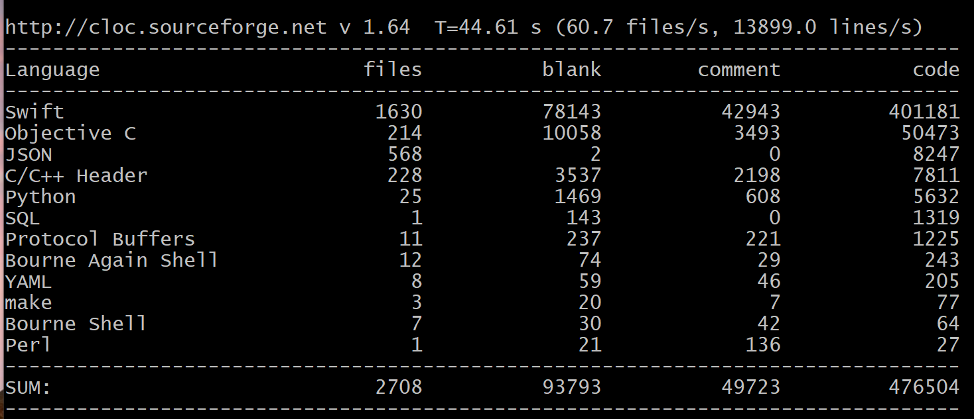
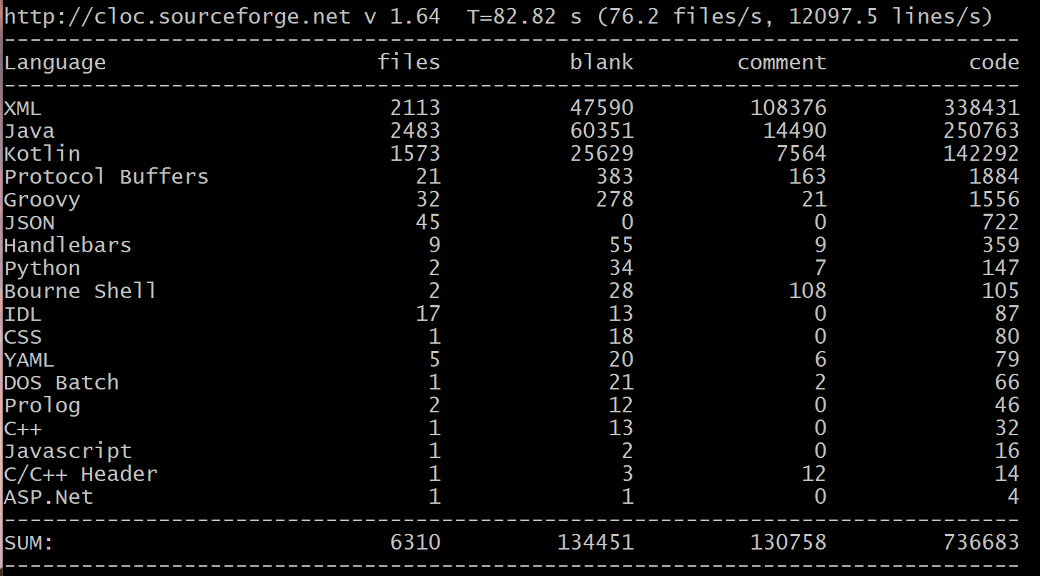
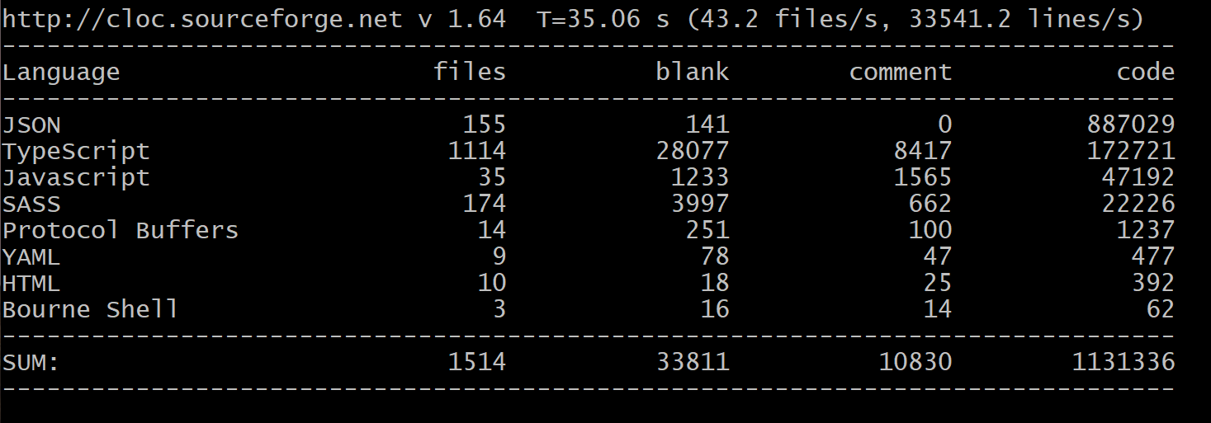
2. A strong business case for Rust app dev
Signal maintains 3 separate app projects, with little overlap
350K LoC
450K LoC
iOS
Android
Desktop
250K LoC
Notes:
In Signal, these app repositories aren’t exactly tiny simple wrappers around a huge shared Rust library. It’s closer to the inverse of that.
As you can imagine, it is incredibly challenging to maintain consistency in both appearance and behavior.
To their credit, Signal has actually done an impressive job of just that, with help from the community, though naturally some things do slip through the cracks.
For example:
On Android – you can place secure Signal chats behind biometric lock, cannot search individual chat only
macOS – cannot screen lock Signal at all, text search UI button doesn’t work, no global search across all chats, no contact-specific notifications
iOS – no font size choice, different defaults, e.g., embedding link preview
Mobile platforms – different data usage settings (WiFi, roaming)

Slide 11
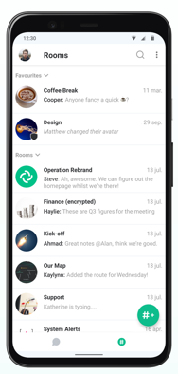
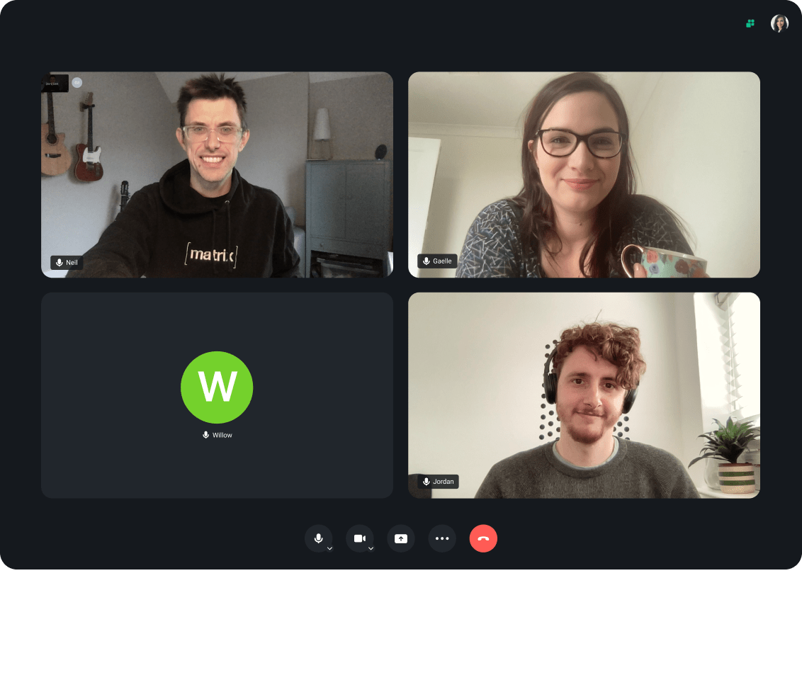

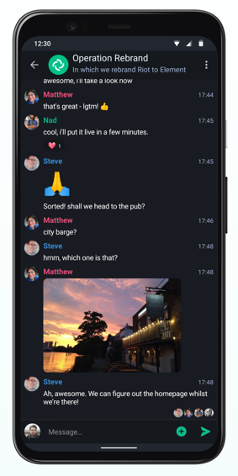
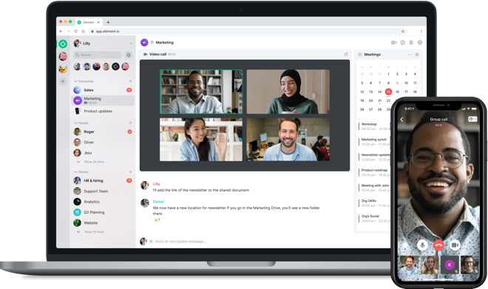
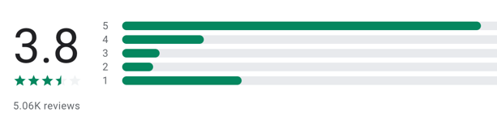

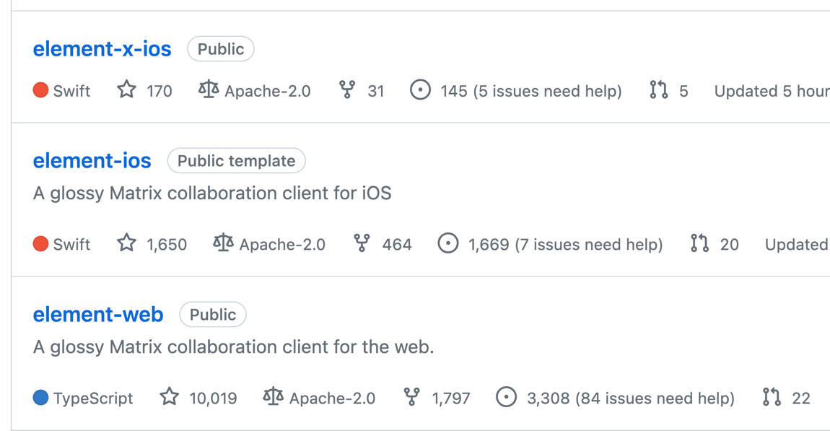
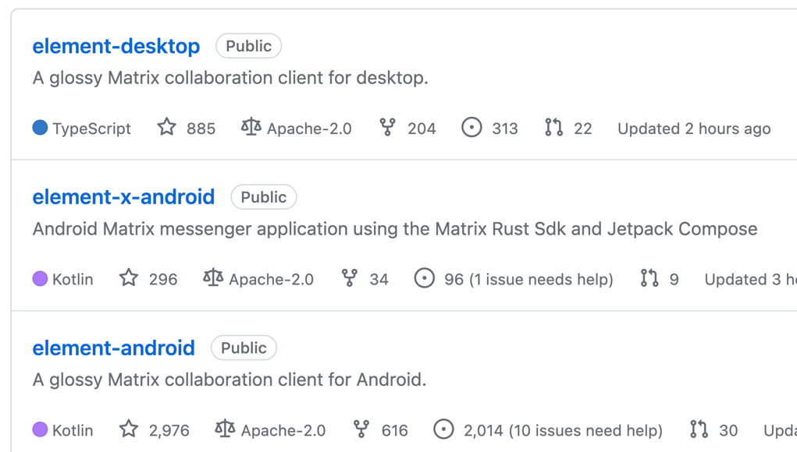
2. A strong business case for Rust app dev
: first-party Matrix chat client
Separate app, SDK repos for each platform
Leads to buggy, inconsistent UI/UX behavior
Notes:
Another similar motivating example is the Element app, a first-party Matrix chat client.
Each version of their app and SDK is in a separate, platform-specific repository, with little to no shared code across the platforms.
This fragmentation is reflected in the user experience, in which users complain about many inconsistencies in the behavior of each app.

Slide 12

2. A strong business case for Rust app dev
Element’s experience of redundant effort led to Compound
“Design-only Flutter”
Compound
Compound is the work-in-progress design system for Element.
What's Compound?
Compound is a shared language and set of UI component implementations for the web, iOS, & Android. Compound is broken down into the following primitives:
Foundations: Guiding principles which inform the basis of any implementation.
Styles: Systems for applying colour, type, spacing, sizing and materials.
Components: Defined components used to build end user experiences.
Platforms
ElementX (iOS & Android), Element Web, ...
Notes:
In fact, Element’s own experience developing these myriad separate applications for each platform led to a new effort called Compound, which is Element’s approach towards creating a design language and set of UI components that are shared across multiple platforms.
This is an ongoing work, but I think it is most comparable to a subset of Flutter that considers only visual UI design.

Slide 13

2. A strong business case for Rust app dev
Devs love Flutter, but love Rust even more
Improves team culture and morale
Using a modern stack attracts talented devs
Higher productivity, higher quality
Multi-platform consistency allows devs to focus on UI/UX quality
Avoid wasting time on minutia of underlying technology platforms
A CTO was … receiving inbound resumes from developers who heard his firm was “a Flutter shop.”
… the result was higher quality work.
… positively impacted team culture.
--
Source: https://verygood.ventures/whitepaper/business-value-of-flutter
Notes:
Survey quote: “Dart is not anyone’s first language”
And while Rust usually also isn’t anyone’s first language, it’s quite often their first language of choice.
Quote: “When we were native only, a lot of conversations were ‘no, because...’ with the blame going to underlying systems.”

Slide 14
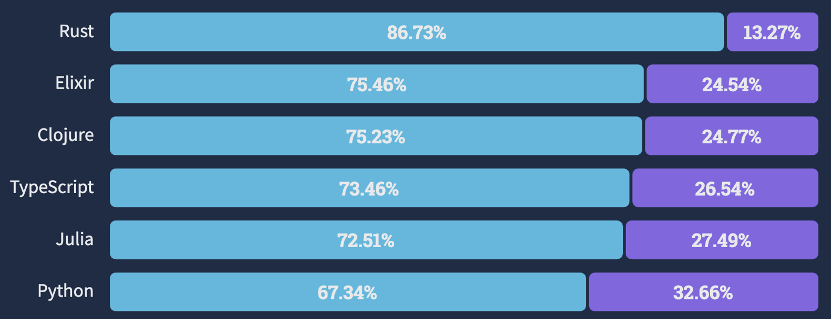
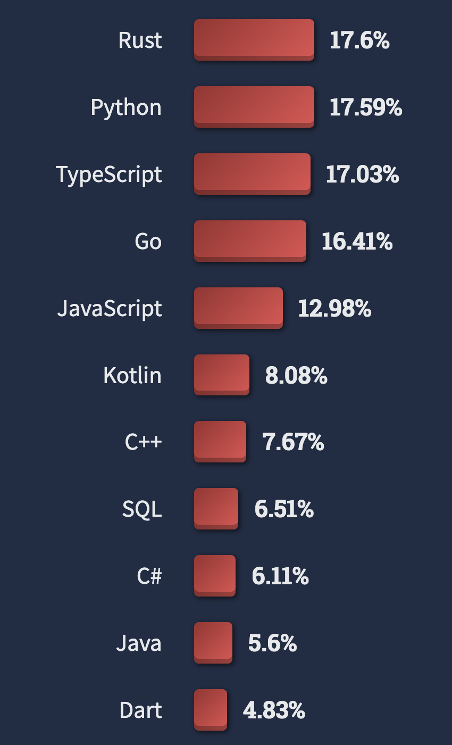
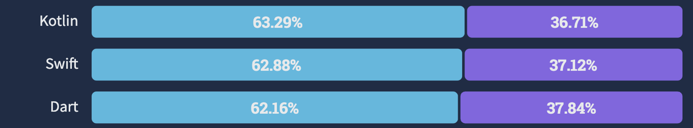

3. Rust itself is the right choice
Most loved language 8 years in a row … and most wanted
Let’s leverage its great featureset for multi-platform app dev:
Rust has already spread (almost) everywhere
Reaches many more domains than Dart
Easy, clear dependency management via cargo
Simple, built-in cross compilation with wide range of targets
Backwards compatibility across compiler versions
…
Notes:
Stack Overflow’s annual survey of 70,000 developers showed that, once again, Rust is the most loved language, this time for the 8th year running.
And for the first time ever, Rust was the most wanted language as well.

Slide 15

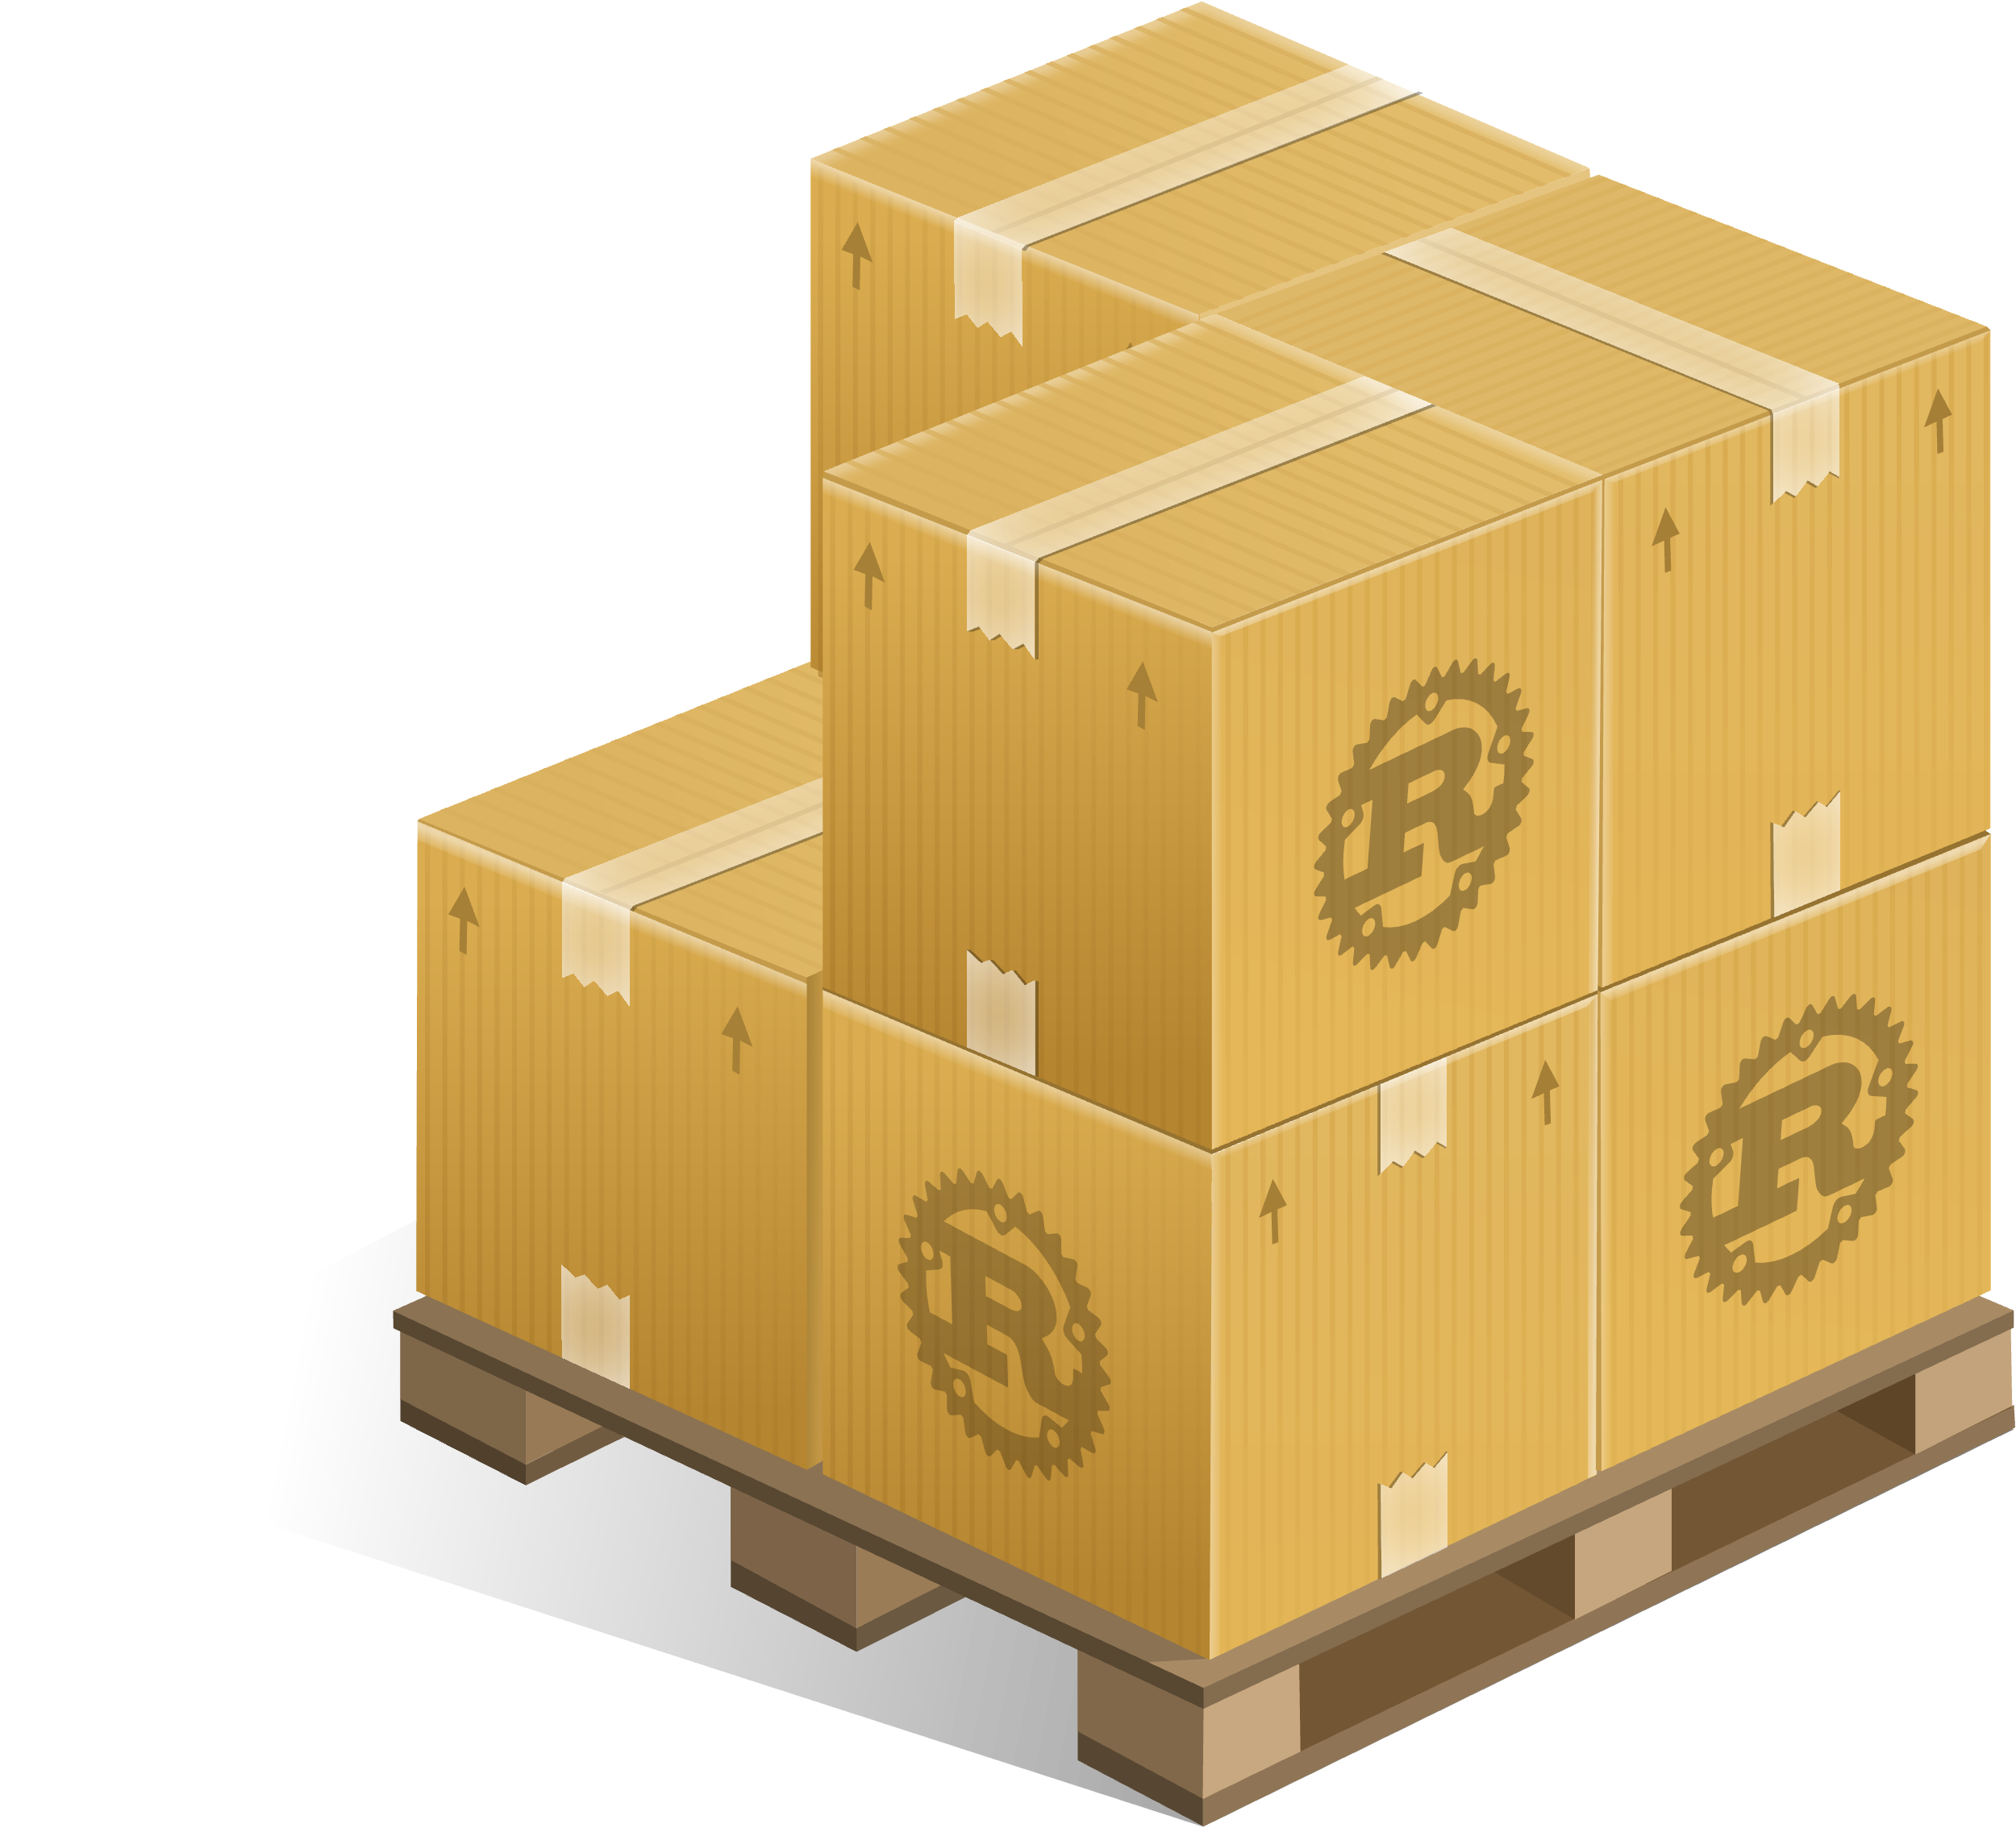



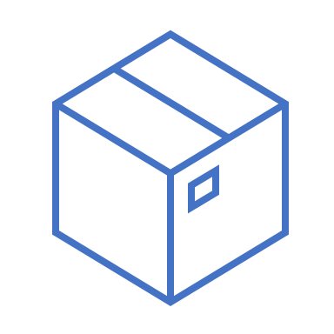
3. Rust itself is the right choice
Leverage Rust’s great features for multi-platform app dev:
Let’s leverage its great featureset for multi-platform app dev:
Rust has already spread (almost) everywhere
Reaches many more domains than Dart
Easy, clear dependency management via cargo
Simple, built-in cross compilation with wide range of targets
Backwards compatibility across compiler versions
Safety, runtime efficiency
Easy, clear dependency mgmt
Simple cross compilation
Ecosystem covers many domains
Notes:
Safety leads to increased correctness, eliminating memory & concurrency bugs
Higher reliability, less developer frustration and debugging difficulties
Amenable to formal verification and type-carried invariants
Less runtime overhead via static (compile-time) checking and guarantees
Focus on zero-cost abstractions (e.g., async state machines)
No garbage collection, static memory lifetime analysis
Monomorphization of generics
const eval, etc
Interactive systems, especially mobile, require good performance and efficiency; achievable with Rust
Performance is key for a smooth, responsive UI without jank
Efficiency is key for longer battery life, less heat output
Backwards compatibility across compiler versions, support for compiler editions
Good, clear dependency management via cargo
Built-in support for easy cross-platform compilation targeting, with a wide range of targets supported at various tier levels

Slide 16
3. Rust is great, but …
Some shortcomings from a UI standpoint
Lack of familiar OOP patterns; UI folks are accustomed to inheritance
Difficult to realize shared mutable state
Typical closure-based callback pattern → overuse of Rc<RefCell<…>>
Compilation is “slow”
But constantly improving … wait for Nick’s talk
Potentially steep learning curve for frontend devs
Mobile devs needed ~3.5 months of retraining to switch to Flutter
--
Source: https://verygood.ventures/whitepaper/business-value-of-flutter
Notes:
Rust has room for improvement in some areas, as it was originally envisioned for systems programming use cases and environments.
VGV survey about Flutter said mobile devs needed to be retrained to used Flutter, took a median 3.5 months
Rust could be even worse, as it is frequently said to have a high barrier to entry

Slide 17
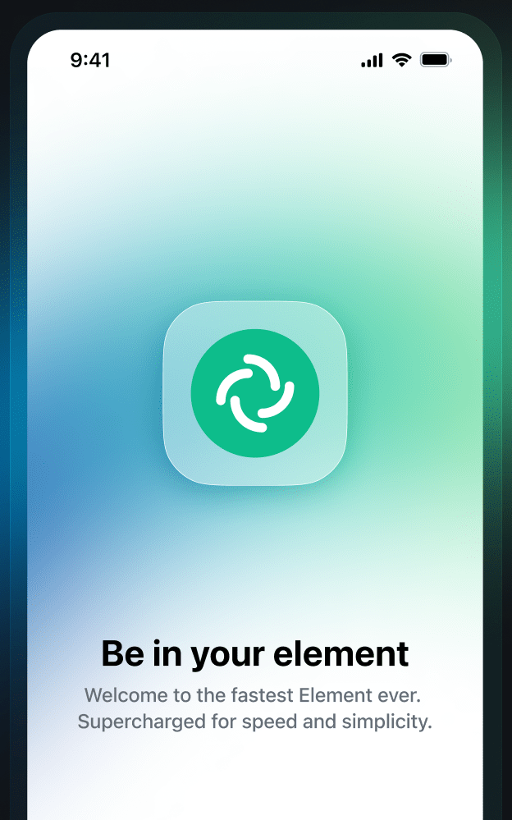
Theme: switching to Rust for huge gains
💪
Element X: “up to 6000 times faster”
Rewritten in Rust, with native frameworks
Rust Matrix SDK + SwiftUI / Jetpack Compose
Speaks to the attitude surrounding Rust
Motivates a cross-platform approach:
We’re releasing Element X today on iOS; you can get it from the App Store (plus it runs well on macOS too, if you have Apple Silicon.) The Android build will follow [soon]…
— Element blog. July 6, 2023
Source: https://element.io/blog/element-x-experience-the-future-of-element/
Notes:
The final, overall motivating theme I want to highlight is the pervasive mentality that switching to Rust will bring huge gains.
A good example is Element’s own experience with app dev.
Element states:
The beauty of Rust Our new Rust SDK makes development faster and more consistent across the Android and iOS apps, while providing a super-speedy and high quality implementation thanks to Rust

Slide 18
Goals

Slide 19

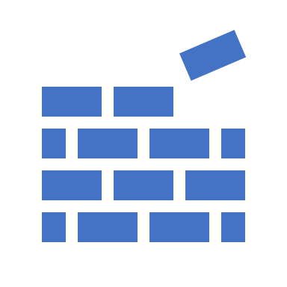



Create reference design of full system stack
Develop flagship apps as proof-of-concept
Establish community, drive ecosystem
Give feedback to Rust & Cargo teams
[Future]
Notes:
Establish community and drive ecosystem
Evangelize & demonstrate the power of Rust to app devs
Not just for systems programming, embedded, OS
Create reference design of full app + system stack
Support major OSes and platform environments
Develop flagship apps as proof-of-concept
[Future] Give feedback to Rust lang/libs, and cargo teams

Slide 20




Establish community, drive ecosystem
Create working group
Track status on an “Are we app yet?” website
Collect set of maintained, functional crates
Attract and support key contributors across system stack
Drive holistic ecosystem documentation, tutorials
Evangelize & demonstrate power of Rust for app dev
It’s not just for systems or embedded projects anymore!
Notes:
Create cross-platform / mobile app dev working group
Host and maintain an “are we app yet” website
Identify and invite key project authors/maintainers in the space
Foster community collaboration, encourage open-source contribution
Publish whitepaper, documentation, tutorials, blogs
[Long term] Evangelize for usage of Rust + Robius in app dev business cases
[Long term] Drive the development of a stable, robust app dev Rust ecosystem

Slide 21
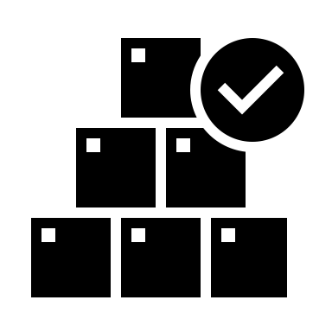
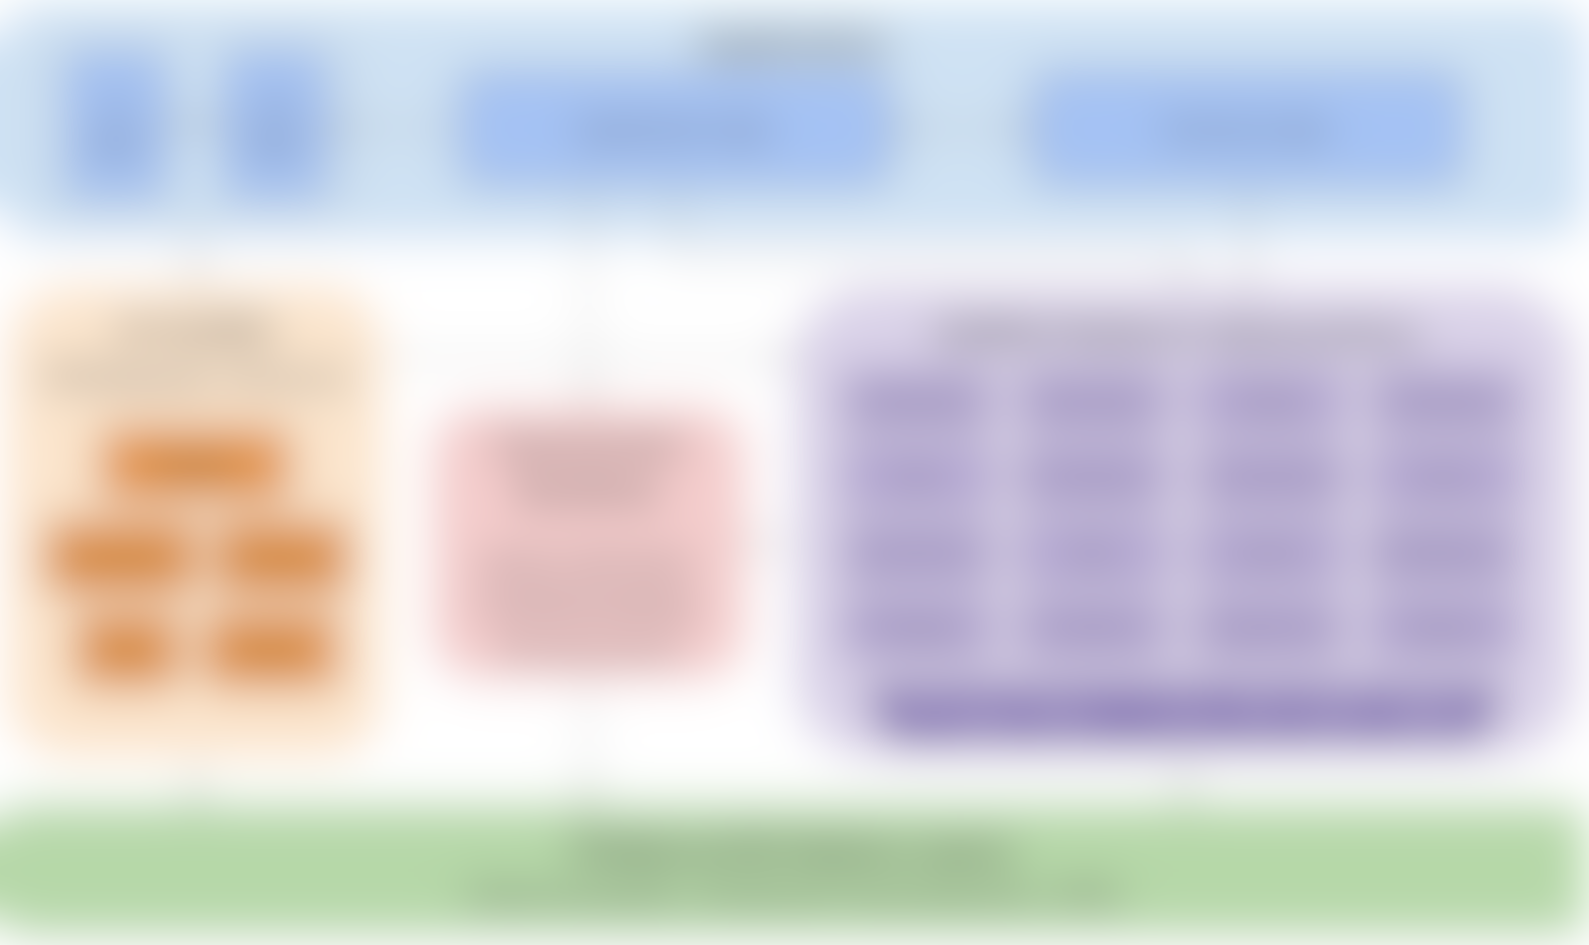
Reference design of full system stack
Complete, working example of everything beneath app
Support major platforms/OS environments
details coming later…

Slide 22
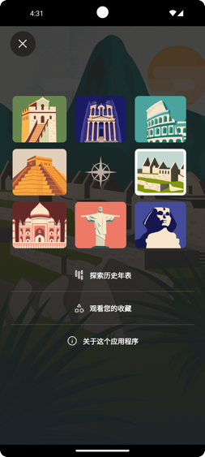

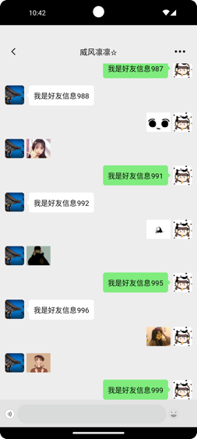
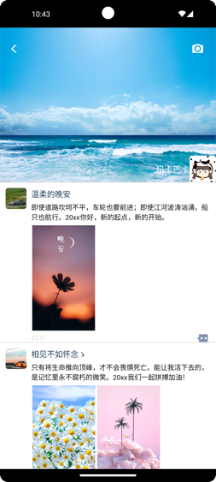
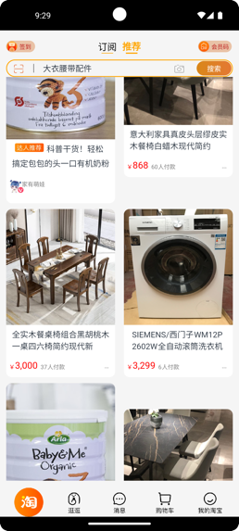



Proof-of-concept demos + flagship app
A series of open-source, ready to use example apps
One major enterprise-grade flagship app
Meta-goal: easy for new devs to fork & modify
Well-commented, well-structured code, plus docs
Notes:
A series of full-fledged, open-source example apps
These are smaller apps that demonstrate specific features, with mock app logic and stubbed-out incomplete business logic
Basic shopping estore app, e.g., amazon, taobao, ebay
News feed / social media, e.g., twitter, facebook
Social Video sharing apps, e.g., tiktok
Notes app, simple text editor, e.g., google keep
Basic drawing app, e.g., paint
Easy for new devs to fork & modify, well-commented with accompanying docs
One flagship app, at least initially, which I’ll discuss on the next slide
: a complete Matrix chat client (FluffyChat clone), similar to Signal
Fully-complete UI, UX, application, and business logic
Multiple separate UI pages with storyboard flows
Authentication, send/recv/sync messages
A/V chat (multimedia I/O): camera, video playback, mic, audio out
Persistent state (config/settings), local data storage, user profiles
Many small (micro)benchmark apps for testing (and CI) of underlying stack
Sensors: simple display of raw input sensor data, plus basic sensor fusion
Screen brightness adjustment slider, plus automatic brightness based on ambient light sensor
Input event dumper – touch, click, hover, drag, scroll, pinch zoom gestures
etc

Slide 23


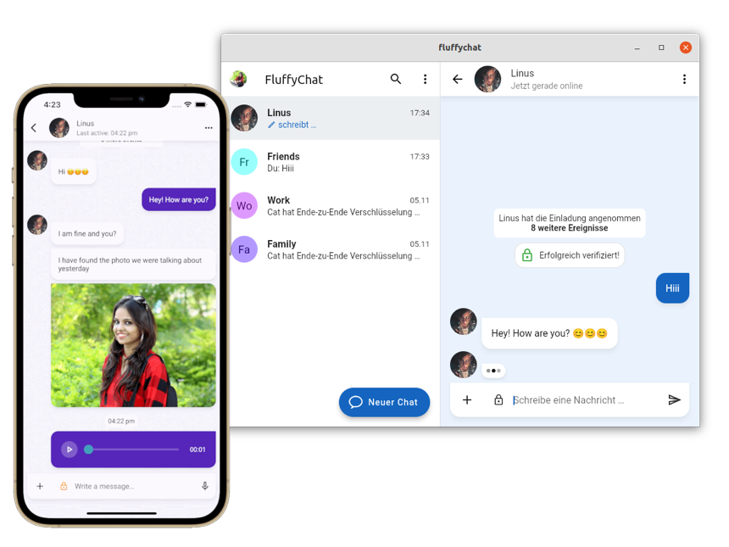
First flagship app – a Matrix chat client
: first-party Matrix chat client
Separate app and SDK for each platform
Leads to buggy, inconsistent UI/UX behavior
Good existing example: FluffyChat
Written using Flutter → consistent behavior
Still requires some platform-specific code
Primarily for building on iOS, Android, web, Windows, Linux, and for different app stores
Notes:
Flagship app: a complete Matrix chat client. I already talked about Element, a first-party Matrix chat client, and the problems it experienced and the path they took to attempt to improve things.
Another good existing example is FluffyChat, a different Matrix chat client that is written in Flutter.
Our goal is for this flagship app to be fully featured:
Have a complete UI, high-quality UX, application logic and business logic
Authentication, send/recv/sync messages
A/V chat (multimedia I/O): camera, video playback, mic, audio out
Persistent state (config/settings), local data storage, user profiles
Ideally our framework can also abstract away all of that

Slide 24
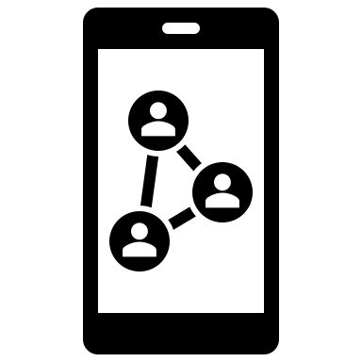



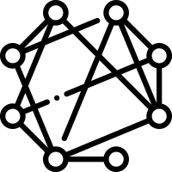

Advertise Robius’s business value
Attract devs/customers via consistent UI+UX
Ability to hire fewer devs with deeper expertise
Only need to know Rust + framework, not multiple platforms
Easier maintainability
Rapid, consistent bug fixes → happier customers
Smooth integration with Rust’s large crate ecosystem
Rust FOSS ecosystem is quite deep, especially beyond UI works
Open-source, distributed, decentralized project structure
… and you get to use Rust!
Notes:
With the flagship app and other demo apps in place, our final long-term goal for the far future is to advertise the business value of the Robius project.
Specifically, we want to focus on the following aspects:
Attract devs/customers via consistent UI+UX
Ability to hire fewer devs with deeper expertise
Only need to know Rust + framework, not multiple platforms
Easier maintainability
Rapid, consistent bug fixes → happier customers
Smooth integration with Rust’s large crate ecosystem
Lean on the significant shoulders of growing FOSS projects
Rust ecosystem is quite deep, especially beyond UI works
Open-source, distributed, decentralized project structure
… and you get to use Rust!

Slide 25
Requirements
Notes:
Now I’d like to cover some of the key technical requirements that are inherent to the success of this vision.
These can also be considered as additional goals, just more on the technical side rather than the project milestones that I just covered.

Slide 26
Technical Requirements
runtime
build, dev
Quick compilation
Efficient, performant execution
Platform policy compliance
Consistent abstractions
Fast app startup
Flexibility for third-party components
Notes:
[runtime] Efficient execution → native performance
[runtime] Fast application startup
Keep binaries small, allow loading libraries at runtime
[dev] Quick compilation times
At least for incremental compilation
Good news: modern app dev UI kits focus on live coding
[dev] Consistency across platforms
But easy to descend beneath abstractions to call platform-specific code
[both] Compliance with platform policy restrictions
Generated app packages must be publishable to platform app stores
e.g., iOS forbids JIT compilation, dynamically loading new code
Could potentially circumvent this by downloading/running WASM code (is this legal on iOS/Android?)
[mostly dev] Flexibility to incorporate third-party components
At a bare minimum, OSIRIS components, standard Rust crates
Fast application startup
Quick compilation times
At least for incremental compilation
Good news: modern app dev UI kits focus on live coding
Consistent abstractions across platforms
But easy to descend beneath abstractions to call platform-specific code
Flexibility to incorporate arbitrary third-party components
At a bare minimum, OSIRIS components
Efficient execution (low runtime overhead) → native performance or better
Compliance with platform policy restrictions
Generated app packages must be publishable to platform app stores
e.g., iOS forbids JIT compilation, dynamically loading new code
Could potentially circumvent this by downloading/running WASM code (is this legal on iOS/Android?)

Slide 27
Efficient, performant execution
Avoid slow communication with platform
High Responsiveness
(low input latency)
Efficiency,
Performance
Rust
Efficient, performant execution
No GC
No runtime
Energy efficiency
(on mobile)
Compile-time safety + eval
Full-system profiling
Notes:
The first and most important requirement falls on the runtime side, which is to achieve high performance and efficient execution.
Efficient, performant execution obviously gives an application a highly responsive feel, that’s no surprise. Typically we refer to this as a low input-to-display latency, an end-to-end measurement of latency from when a user interacts with an application until when the results of that interaction are displayed on screen.
This requirement also factors into energy efficiency, which is of particular importance on mobile and embedded devices where battery life is a concern, though it also doesn’t hurt to be energy efficient in regular wall-powered systems too.
Low runtime overhead → native performance
Rust is “on trend”: no required underlying runtime, no concurrent GC
Heavy focus on compile-time operations, zero-cost abstractions
Support easy full-system tracing/profiling
Built-in benchmarking infrastructure for easy regression testing
Avoid inefficient communication with platform
Many slow approaches based on serialization, message passing IPC
Energy efficiency is particularly important on mobile

Slide 28
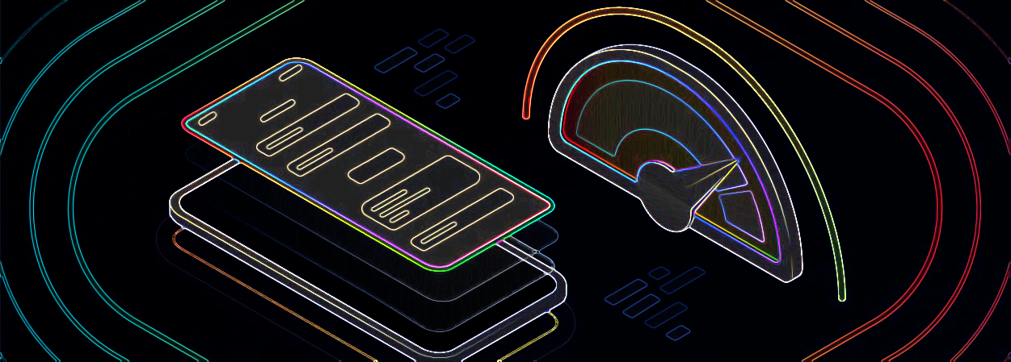
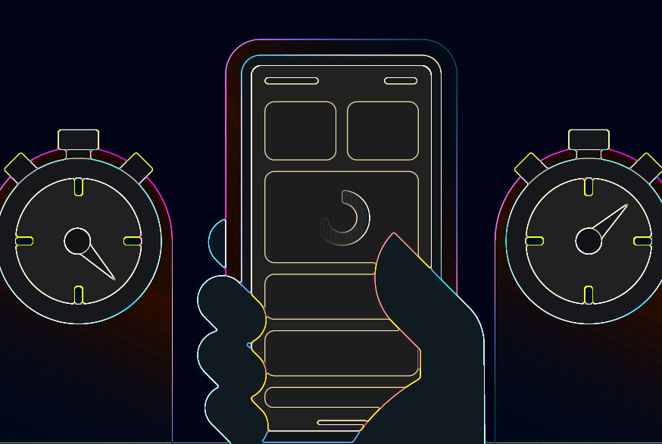
Fast app startup
Mobile guidelines: 1.5–2 sec
Good: Rust AOT compilation
No JIT overhead at startup
More consistent general perf, lower theoretical max perf
Bad: large app binary sizes
Side benefit: helps shorten iterative development cycle
Notes:
More than 10 years ago, Amazon found that every 100ms of latency cost them 1% in sales. In 2006, Google found an extra .5 seconds in search page generation time dropped traffic by 20%.
70% of mobile app users will abandon an app if it is taking too long to load ((Source: Think Storage Now)
53% of your site visitors will leave if your site takes longer than 3 seconds to load.
According to another study, 49% of users expect apps to start in 2 seconds or less.
Based on an analysis of the top 100 Android apps, 39 apps start in under or around 2 seconds, and 73 in under 3 seconds. Ideally, most developers should target an app launch time of 1.5-2 seconds.
--------------------------------------------------
Mobile guidelines “time to initial display” (TTID):
Cold start (incl. process creation): 2-5 seconds, iOS recommended <= 3 sec
Warm start (incl. activity creation): 1-2 seconds
Hot start: under 1.5 seconds
Ideal time to display at least something: 200-500ms
-----------------------------------------------
Rust performs full AOT compilation
No JIT overhead → general perf is more consistent, but lower theoretical max
Smaller application binary also helps (e.g., reduced dynamic linking time)
Rust’s binaries are notoriously large
Benefits developers by shortening iterative dev cycle

Slide 29

Quick compilation
Modern Rust UI kits combat this with live reloading of DSL elements
Structure of many small crates
Benefit: parallel compilation units
Fast incremental compilation (at the very least)
“Rustc is slow” — the internet
Notes:
Rust compilation time has long been a contentious issue
Significant work from the compilers team to speed up rustc
Honestly not nearly as bad as the internet hivemind seems to think.
Robius: strive for structure of many small crates
Benefit from largely parallelizable compilation units
Modern Rust UI kits combat this with live reloading of DSL elements
Makepad goes further to minimize dependencies for fast compilation
Custom-tailored subset of platform framework dependencies
Fast incremental compilation (at the very least)

Slide 30

Consistency across multiple platforms
Key principle:
Devs shouldn’t be required to touch platform-specific code
But should be able to if desired, with relative ease
Secondary: platform-agnostic code imposes no overhead
Or as close to underlying native platform as possible

Slide 31

Flexibility to incorporate arbitrary components
Build system and tooling must easily allow adding custom deps
Initially, support choice of one of multiple UI toolkits
Future: replace default components with custom substitutes

Slide 32

Error: The app references non-public symbols in <path>. If method names in your source code match the private Apple APIs listed above, altering your method names will help prevent this app from being flagged in future submissions. In addition, note that one or more of the above APIs may be located in a static library that was included with your app. If so, they must be removed.
Error: Invalid Bundle Structure - The binary file <…> is not permitted. Your app can’t contain standalone executables or libraries…
Generated app packages must be publishable to app stores
✅ Platform abstractions we provide must adhere to publisher-specific policies
🚫 Private APIs, JIT, loading arbitrary executables
Full compliance with platform policies
They must be packaged and submitted using technologies provided in Xcode; no third-party installers allowed. They must also be self-contained, single app installation bundles and cannot install code or resources in shared locations.
Notes:
Some examples of things we cannot do within the app dev framework:
Examples:
iOS forbids JIT compilation
Android no longer allows loading class files from native code via JNI, which isn’t needed because ART performs AOT compilation
Sample errors:
--------------------
Error: The app references non-public symbols in <path>. If method names in your source code match the private Apple APIs listed above, altering your method names will help prevent this app from being flagged in future submissions. In addition, note that one or more of the above APIs may be located in a static library that was included with your app. If so, they must be removed.
Error: Invalid Bundle Structure - The binary file <…> is not permitted. Your app can’t contain standalone executables or libraries…
Note: applications must be packaged and submitted using technologies provided in Xcode; no third-party installers allowed. They must also be self-contained, single app installation bundles and cannot install code or resources in shared locations.

Slide 33
Reference Design

Slide 34
A sketch of system architecture
Incorporate many components across open-source ecosystem
UI toolkits
Game engines
Abstractions of OS/platform native interfaces & services
Concurrency abstractions: async tasking, multithreading
[Future] Client-side libraries for remote services (Open Mobile Hub)
Why call it a “reference design”?
Pre-integrated solution for a known-working app dev experience
Architecture of loosely-coupled components; reusable elsewhere
Advanced devs can tailor stack to meet complex needs
Notes:
Why call it a “reference design”?
It should serve as a one-stop shop for developers to grab a comprehensive solution for Rust app dev that just works off the shelf.
Think of it as tier 1 support for “blessed” combo of projects
Flexible componentized architecture of loosely-coupled pieces that can be reused beyond this supported combination, the main idea being that advanced developers can either bring in outside components to mix them in with others in the supported set or replace the existing components entirely, and they can take these components and reuse them in other domains beyond Robius, if desired.
This is similar to other working groups, such as the Rust embedded working group which organizes projects for microcontrollers, peripherals, etc. They have a series of crates that are intended to work with each other in certain ways, but aren’t restricted to that. (e.g., I have reused some of their register abstractions in Theseus and other non-embedded contexts)

Slide 35
Reference Design of Full System Stack
Application
UI logic
UX logic
Application logic
Business logic
UI toolkit (Makepad) (Dioxus)
OSIRIS Platform Abstractions
Networking
State mgmt
Storage
Multimedia
Widgets
Concurrent Runtime
async executor, multithreading, thread pools
Power
Permissions
Connectivity
Sensors
Animation
Gestures
Input Events
Audio
Location
Notifications
Events
Render
IPC/Signals
Time/Alarm
Drag & Drop
Clipboard
FFI layer (Rust → native language)
Platform/OS Native Layers (Android, iOS, HarmonyOS, Desktop, etc)
Notes:
UI toolkits – Makepad, Dioxus, Slint
Offers a variety of UI development options and styles
Generally cross-platform, with a focus on GUI design and workloads
OSIRIS - OS Interfaces in Rust
Rust abstractions of platform and OS-specific functionality
Focus on non-GUI subsystems
Standard subsystems: networking, storage, audio, time
UI-adjacent services: notifications, clipboard, drag & drop
Mobile-oriented:
Sensors/actuator: accelerometer/gyro, ambient light, pressure, temp, vibration, location, buttons, LEDs, biometrics
Multimedia: camera, mic, speaker
Touch screen, display brightness
Connectivity: WiFi discovery, bluetooth, NFC, USB, phone modem
Power: battery, charging, idle/standby/awake status
Permissions management: declaring, requesting, revoking
Goal: easy to integrate OSIRIS into a UI app as a dependency
Low-/zero-cost abstractions, as close to native as possible
Future: high-level, off-system mobile services
RESTful APIs: mapping, authentication, Google Play services, etc
Can likely use or start from the foundation of Open Mobile Hub
Concurrent / parallel computation runtime
Async execution runtime – ylong, tokio, async-std (smol)
Threads, thread pools, and CPU/multicore abstractions
https://www.openmobilehub.com/getting-started/

Slide 36
Application
UI logic
UX logic
Application logic
Business logic
Guiding philosophy: stay out of UI’s way
Let UI experts do what they do best
UI toolkit + app logic act as active driver
OSIRIS, others are supplementary
Independent from UI
Passive libraries, driven by app
UI toolkit (Makepad) (Dioxus)
OSIRIS Platform Abstractions
Networking
State mgmt
Storage
Multimedia
Widgets
Concurrent Runtime
async executor, multithreading, thread pools
Power
Permissions
Connectivity
Sensors
Animation
Gestures
Input Events
Audio
Location
Notifications
Events
Render
IPC/Signals
Time/Alarm
Drag & Drop
Clipboard
FFI layer (Rust → native language)
Platform/OS Native Layers (Android, iOS, HarmonyOS, Desktop, etc)
Notes:
Guiding design philosophy: stay out of the UI’s way
Let the UI experts do what they do best
UI toolkit and application logic are the active driver
Toolkit defines application entry point and main UI/UX event loop
Provides all abstractions for system graphics APIs
OSIRIS and other components are supplementary
Fully distinct from and independent of UI
Act as passive libraries
Not concerned with graphics abstractions

Slide 37
Application
UI logic
UX logic
Application logic
Business logic
Flexibly integrate multiple UI kits
Devs can choose a familiar UI model
Challenge: how to compose UI toolkits
→ Help new devs gradually transition to Rust, lower layers
UI frontend
Dioxus
OSIRIS Platform Abstractions
Networking
State mgmt
Storage
Multimedia
Concurrent Runtime
async executor, multithreading, thread pools
Power
Permissions
Connectivity
Sensors
UI toolkit (Makepad) (Dioxus)
Input Events
Audio
Location
Notifications
IPC/Signals
Time/Alarm
Drag & Drop
Clipboard
Animation
Gestures
Render
FFI layer (Rust → native language)
Platform/OS Native Layers (Android, iOS, HarmonyOS, Desktop, etc)
Notes:
Another interesting option we’re exploring is the ability to integrate multiple UI toolkits, such that a developer can choose the UI model they’re most comfortable with.
For example, a developer that’s more familiar with React Native or web-based frameworks would likely find it easiest to use Dioxus.
Depending on the level of integration we’re able to achieve, a higher-level UI framework like Dioxus doesn’t necessarily have to exist atop Makepad’s engine, but it could.
ArkUI (an up and coming framework) may also want to use these underlying Rust framework layers to improve its perf, and remove reliance on Skia
Goal: attract frontend/app/UI developers that aren’t comfortable with Rust

Slide 38
Application
UI logic
UX logic
Application logic
Business logic
Bring UI and game engines together
Game engine can use and drive UI framework
Incorporate UI features and OSIRIS to simplify non-gameplay function
Game engine
(Bevy)
OSIRIS Platform Abstractions
Networking
State mgmt
Storage
Multimedia
Concurrent Runtime
async executor, multithreading, thread pools
Power
Permissions
Connectivity
Sensors
UI toolkit (Makepad) (Dioxus)
Input Events
Audio
Location
Notifications
IPC/Signals
Time/Alarm
Drag & Drop
Clipboard
Animation
Gestures
Render
FFI layer (Rust → native language)
Platform/OS Native Layers (Android, iOS, HarmonyOS, Desktop, etc)
Notes:
An application can also incorporate a game engine like Bevy, whose logic could be driven by the game engine while still being able to utilize other platform-agnostic components of the ecosystem.

Slide 39
Application
Application
UI / UX
Convos/ rooms list
Chat view
Room browser
Application logic
Business logic
Persistent settings
Push notifs.
Local msg database
Online status
File sync
Join/ leave room
Matrix message send/recv
read status
Settings, Themes
In-app notifs.
Context for chat/msg
Flagship App Architecture
(Matrix Chat Client)
Feature development for this app will steer OSIRIS and UI toolkit integration
Image viewer
Create or delete chat
Quick replies
Access camera, mic, speaker
Multi-device login mgmt
Account management
Contacts
Video display
File/media chooser
Search
Rich text fmt
Multimedia streaming, calling
Reactions
Local media storage
Authentication
Thread view
Reply linking
UI toolkit (Makepad, Dioxus)
OSIRIS Platform Abstractions
Concurrent Runtime
Concurrent Runtime
async executor, multithreading, thread pools
Networking
State mgmt
Storage
Multimedia
Widgets
async executor
multi-threading
Input Events
Audio
Connectivity
Notifications
Animation
Gestures
Permissions
Drag & Drop
Clipboard
Events
Render
thread pools, affinity
FFI layer (Rust → native language)
Platform/OS Native Layers
Notes:
We will lead the development of this app to help drive the design of OSIRIS and prioritize which service abstractions we implement first.
We expect this application to consist of quite a few entities spread across the application, both for app logic and business logic,
as well as significant UI and UX components that will serve as valuable stress tests for the UI toolkits, which are still in active development.
One good thing about this choice of application category is that there are several existing examples,
which we can use as a basis of comparison to help evaluate key aspects of Robius like overall performance, ease of development, and more.
Those applications include:
Element, the first-party Matrix chat, and their newer apps Element-X that I previously mentioned,
Fluffychat, a Matrix chat client written in Flutter,
Quadrix
Cinny
Schildi Chat

Slide 40
Parting thoughts

Slide 41




The path towards Robius
Newly embarking on this journey
Working group announcement coming soon
Initial pre-alpha reference design in several months
Detailed status in upcoming talks
Notes:
you can look forward to more detailed status reports from each of the individual project creators or maintainers today and tomorrow

Slide 42


Thanks!
Interested? Please reach out:
@project-robius
@kevinaboos
kboos@futurewei.com

Slide 43
BACKUP SLIDES

Slide 44
Flutter vs. Robius – fundamentally different approaches
Flutter devs must learn new language, Dart
Robius is a decentralized, loosely-coupled effort
Not owned by a single entity
Not a black box like Flutter or React Native
Fills the vacuum in Rust
Efforts already ongoing across many related subdomains in Rust
Built in a bottom-up manner to serve Rust community first
Rust community usage is our primary concern
Architecture supports selection of components specific to your needs
Devs can descend into and understand lower layers to optimize their apps and the system stack itself accordingly
No intent to compete with or replace Flutter
Notes:
“implementing Flutter on top of Rust is a very attractive proposition; simply cloning the design decisions of Flutter is likely to yield a quite competitive system.”
-- Andy Wingo, from Igalia’s recent 2023 report on cross-platform mobile app frameworks

Slide 45

Incorporate feedback into Rust/cargo
Leverage app & framework design experience to improve Rust
Already in-progress, driven by UI toolkits and system packagers
Need better top-level build tool surrounding cargo
Need ability to hook into cargo commands, e.g., post-build action
Need to inject metadata into build, query it later
Better unified configuration space to define build inclusion
Outside cargo (e.g., Make vars), within cargo (--features), within rustc (--cfg)
Better, more flexible features with saner default-features toggle
Existential dependencies
Notes:
"existential" dependencies/items -- must select only one crate of many that provides a particular interface -- would allow defaults, but could be overridden by higher-level crates -- good for platform-specific backends -- ideally dependent upon the build target -- default value should be auto-detected -- Olivier (from slint): would like these semantics: if backend A is available, then use it. Otherwise fallback to backend B

Slide 46
The role of WebAssembly (WASM)
We may be able to leverage WASM for easier deployment
Mostly for apps on the web, plus Desktop platforms
Mobile app stores disallow downloading and running arbitrary code
Rust has first-class support for targeting WASM
Most of the WASM ecosystem prioritizes Rust integration
Component model can help mitigate large-sized app binaries
Delivery over the web could only transfer app binary
Re-use libraries, shared components already on the client

